Slide 1

Department for the Economy (DfE)
Statistics Workplan 2026/27

Slide 2

Contents Page
Context and overview
Northern Ireland Statistics and Research Agency (NISRA)
Code of Practice for Statistics
Programme for Government
DfE’s Business Plan
Post 16 Education and Training Statistics Workplan
Overview of teams and main publications (Pg 7)
Strategic enablers (Pg 20)
Energy and Circular Economy Workplan
Overview of teams and main publications (Pg 27)
Strategic enablers (Pg 35)

Slide 3
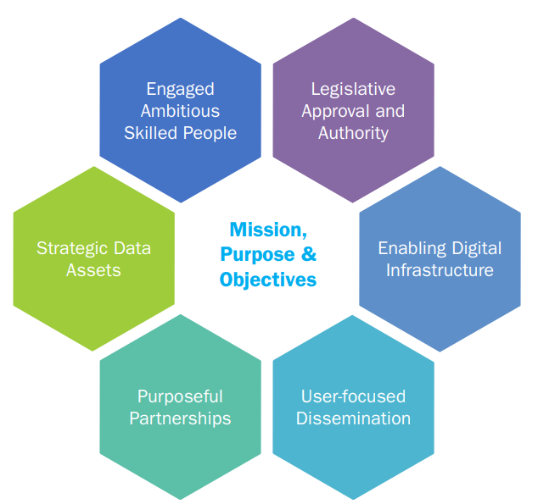
Context and Overview
We are NISRA statisticians seconded to the Department for the Economy.
We contribute to NISRA’s vision to deliver the key statistical, analytical, research and registration services which are needed to improve the lives of people of Northern Ireland. We want to collect, analyse and publish the key information which users need to make important decisions, to the benefit of the shared economic and social objectives of government in Northern Ireland and the broader public good.
We help to achieve the vision through NISRA’s six strategic enablers.

Slide 4
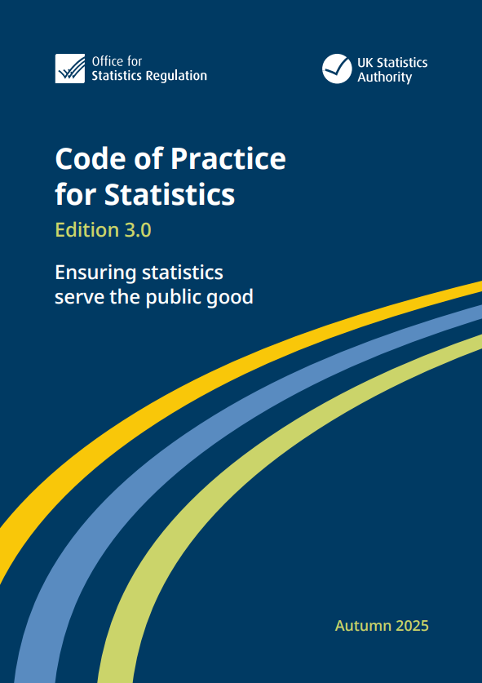
Context and Overview (2)
We follow the Code of Practice for Statistics.
The Code of Practice for Statistics
sets the standards that those producing official statistics should apply to deliver statistics that serve the public good.
The Code is based on three core principles:
Trust
Quality
Value
Our policy statements related to the Code and publication schedule are available on the DfE website: Publications schedule, statements and consultations | Department for the Economy
We follow the Government Social Research Code when producing or commissioning research.

Slide 5

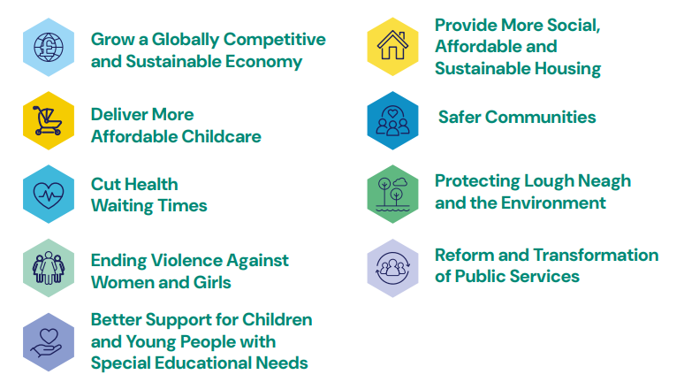
Context and Overview (3)
We provide statistics and produce analysis to support the Programme for Government.
We publish indicators on the PfG Wellbeing Framework to help monitor progress towards PfG commitments.

Slide 6

Context and Overview (4)
We produce statistics, research and analysis to support policy making, programme delivery, monitoring and evaluation in DfE.
Our work provides a robust evidence base for the Minister for the Economy’s Vision and for supporting metrics DfE’s Business Plan.
The vision prioritizes:
Good Jobs
Productivity
Regional Balance
Decarbonisation

Slide 7
Post-16 Skills and Education Statistics Work Plan
Our publication schedule sets out the dates we publish our bulletins on the DfE website. This is the most visible part of our workplan.
We work on areas that underpin the production of high-quality statistics too. This includes actions we take to produce our statistics more efficiently. In 2026/27 we will improve our methods to increase efficiency, continue to review the content and format of our outputs as well as extending analysis of UK sources of information.
Our workplan on the following slides provides an overview of our teams and publications and details the areas we are developing in 2026/27. The slides are arranged by the strategic enablers in NISRA’s corporate plan.

Slide 8
Engaged Ambitious Skilled People
Post-16 skills and education statistics are produced by three teams in DfE. Each team is led by a Principal Statistician.
Higher Education Sector Statistics and Research – Carole-Ann McKay
Further Education Sector Statistics and Research – Brian French
Youth Training Statistics and Research – Jamie Stainer
The lead statistician in DfE is Cathryn Blair, Senior Principal Statistician.

Slide 9
Higher Education Sector Statistics and Research Team
Principal Statistician
Deputy Principal Statistician
Assistant Statistician
Assistant Statistician
Deputy Principal Statistician
Assistant Statistician
Assistant Statistician
Surveys and Widening Participation
HE Statistics and HEI Support

Slide 10
Our Annual Publications
HE Factsheets
Key factsheets:
Age Participation Index
Equality Categories
Narrow STEM
HE Institution Qualifications
HE Institution Enrolments
FE Outcomes
Graduate Outcomes
(to be developed)

Slide 11
HE publication schedule
Our annual publication cycle was disrupted due to significant changes in how data were collected and processed. As a result we published 2023/24 in December 2025 while HESA released 2024/25 data in January 2026.
We plan to release our 2024/25 statistical bulletins in August 2026, bringing us in line to produce 2025/26 publications when HESA release their data (likely December 2026).
To focus on getting our publication schedule back in alignment with HESA, we will not produce HE factsheets until after 2024/25 publication (August 2026). The updated factsheets will have 2 years of additional data.
We plan to publish 1 factsheet per month after the annual publication. We will seek feedback on the factsheets and keep our approach under review.

Slide 12


Extending our analysis
Our team provides statistical support to HESA and the Office for Students in the administration of the Graduate Outcomes Survey and the National Students Survey for Northern Ireland.
During 2026/27 we will consider how to develop outputs based on the data from these surveys.

Slide 13
Further Education Sector Statistics and Research Team
Principal Statistician
Deputy Principal Statistician
Assistant Statistician
Assistant Statistician

Slide 14
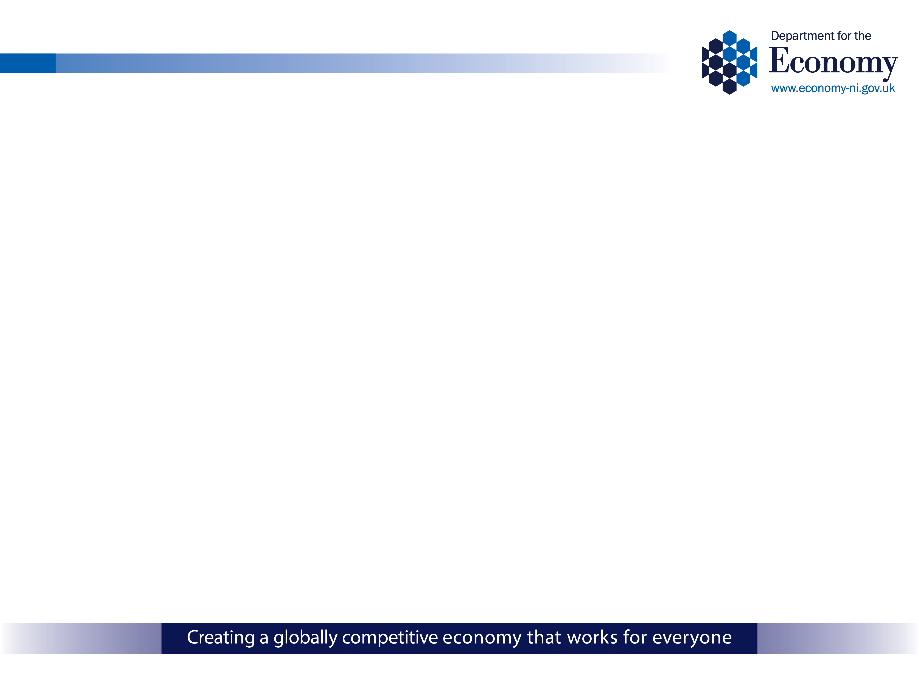
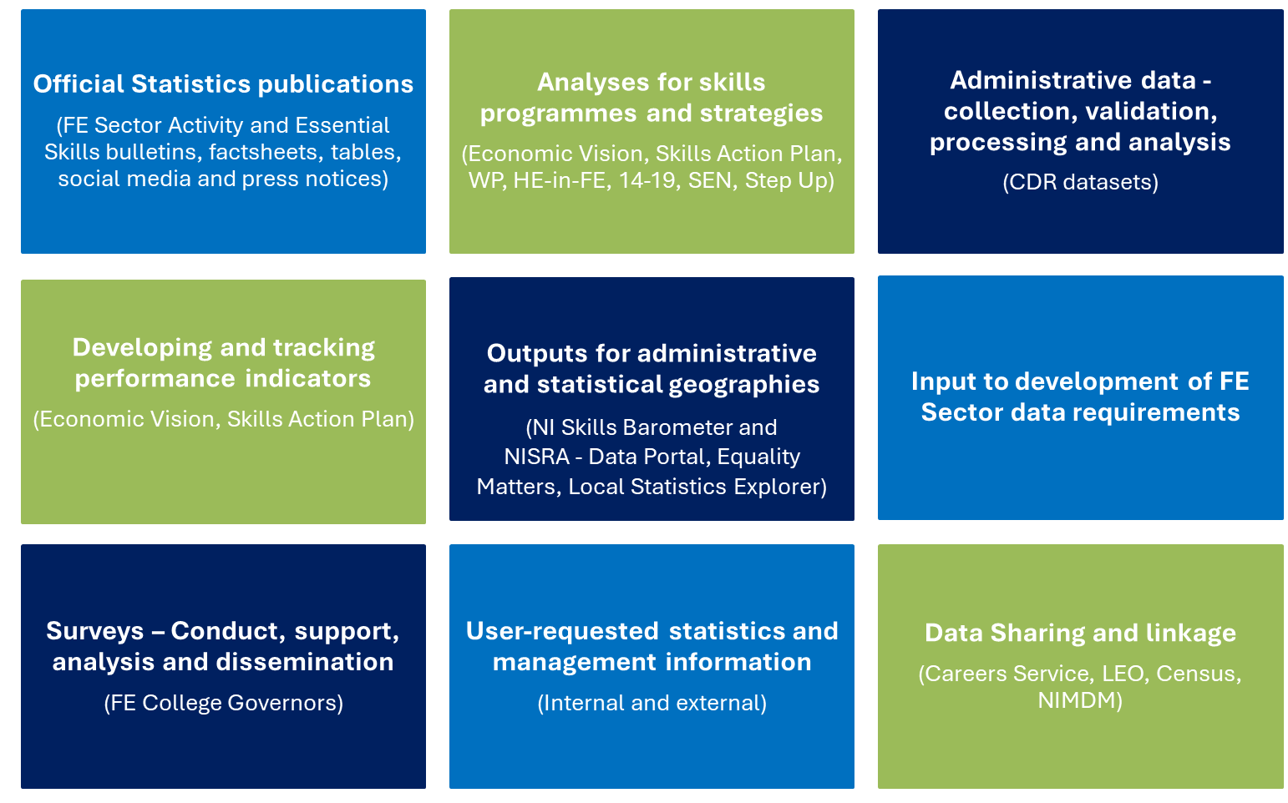
We provide a core FE statistics service to DfE and its customers

Slide 15

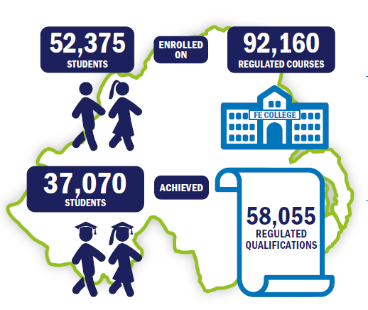
Further Education Sector Activity infographic

Slide 16
Our Key Outputs – bulletins and tables
FE Sector Activity in Northern Ireland
Essential Skills Enrolments and Outcomes in FE Colleges
FE Sector Activity by LGD and Assembly Area
FE Sector Activity commissioned tables (~100 published annually)
Internal MI requests (from across DfE Skills and Education Group)

Slide 17
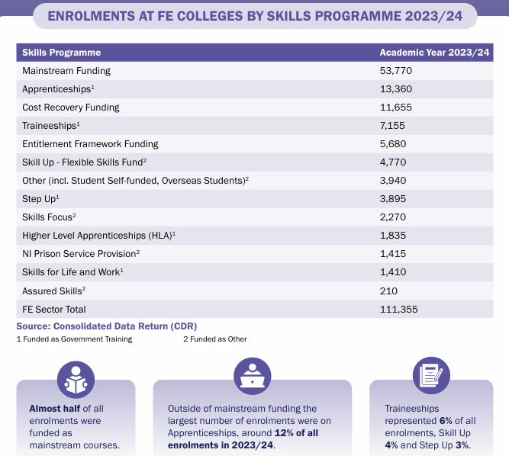
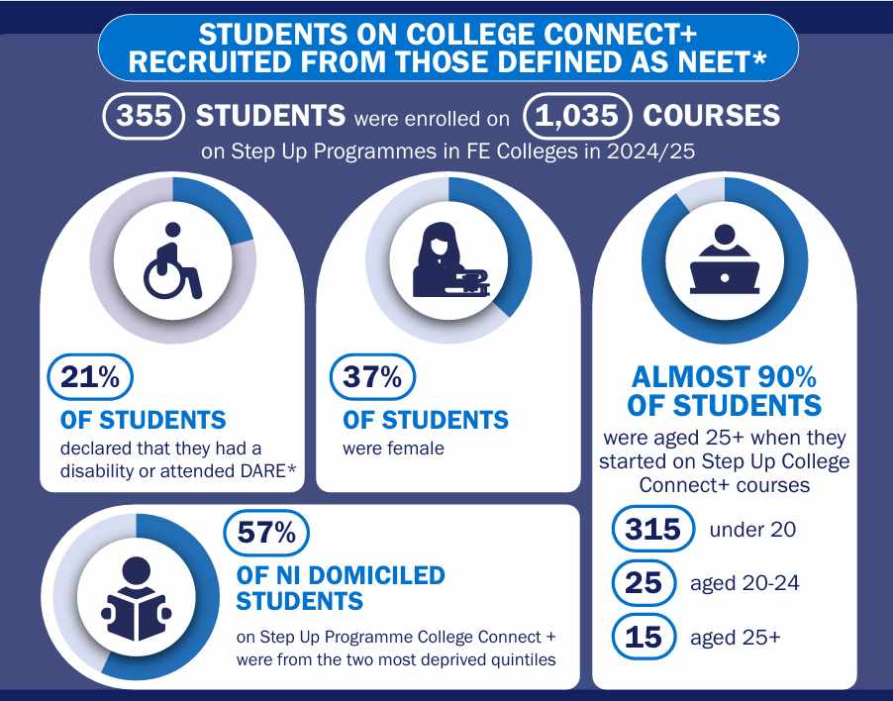
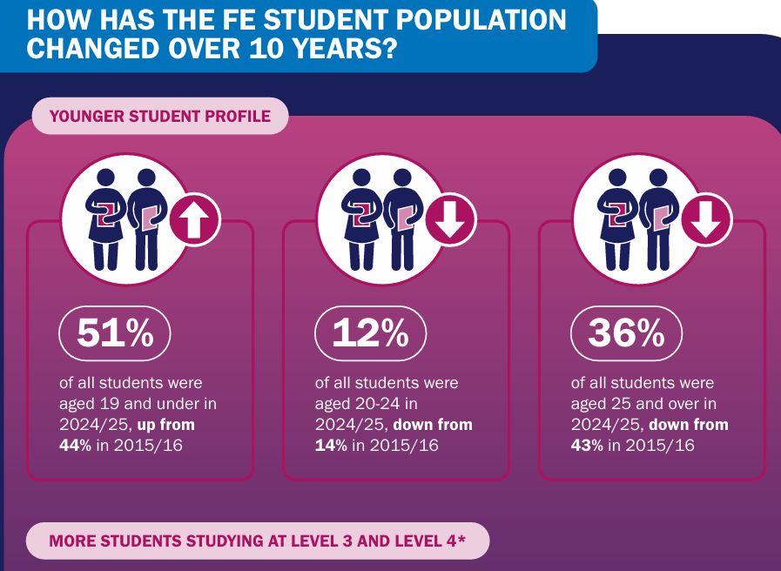
Our Key Outputs - factsheets
New bespoke outputs, co-designed for / with key customers
  Step Up Programmes factsheet
  Skills Programmes factsheet
  Characteristics of Students over 10 years factsheet
  S75 achievements tables for Equality Commission and Equality Matters

Slide 18
Youth Training and Apprenticeships Statistics and Research
Principal Statistician
DP Statistician
(AppsNI, Skills for Life and Work)
Assistant Statistician
Assistant Statistician
DP
Statistician
(LEO)
DP Statistician
(Higher Level Apprenticeships)
Assistant Statistician
(SEND)
Assistant Statistician

Slide 19
Official statistics outputs and analysis
Skills for Life and Work
Young Peoples Behaviour and Attitudes Survey
Higher Level Apprenticeships in HE
Apprenticeships NI
HLA Employers
Special Education Needs Factsheet
Participation in Education and Training
Level 2 Traineeships
Higher Level Apprenticeships in FE

Slide 20
Strategic Data Assets
We will work with NISRA’s Research Support Unit to launch the Longitudinal Education Outcomes (LEO) datasets to researchers in the summer of 2026, with a formal launch event in the autumn of 2026. We will help to develop materials for use by researchers alongside the Longitudinal Education Outcomes (LEO).
We will submit three applications to carry out research on LEO in 2026/27. These will cover Widening Participation, Special Education Needs Pathways and STEM students.
We will develop or update data sharing agreements with NISRA to help shape population estimates, the Census 2031 and the update to the NI multiple deprivation measures. Where we don’t directly supply data, we will share our expertise or support NISRA’s data requests to external data owners.
We will safely link an extract of NISRA’s Inter Departmental Business Register (IDBR) to Higher Level Apprenticeship data to unlock insight on the type and location of businesses employing apprentices. We will publish the analysis on the DfE website.

Slide 21
Enabling Digital Infrastructure
RAP (reproducible analytical pipelines) and HTML outputs are well developed for current HE publications. During 2026/27 we will document our processes based on the General Statistics Business Processing Model (GSBPM) and improve our RAP.
FE Outcomes Bulletin and Essential Skills are produced in an HTML format. During 2026/27 we will also work with NISRA’s Tech Lab to develop interactive tables to accompany the FE Sector Activity report.
The Skills for Life and Work and Participation in Full-time Education and Vocational Training publications will move to HTML formats. The research publication, Employer Participation in Higher Level Apprenticeships across NI 2025, will also be produced in HTML.

Slide 22
Key Stakeholders, Purposeful Partnerships and User-focused Dissemination
We work with a range of people inside and outside of DfE and NISRA.
In many cases our stakeholders own or collect the data we use to produce official statistics. We work with them to shape the collection of information from HEIs and FE Colleges and agree on the safe and proportionate supply of data to us.
Our stakeholders include the customers, or end users, of the data. This can include officials developing policies and delivering programmes in DfE, Further Education Colleges, Higher Education Institutions and external training providers.
The learners our official statistics publications are based on are also our stakeholders – those studying at FE colleges, HE institutions or working and learning through a DfE funded apprenticeship.

Slide 23
List of Key Stakeholders
Government Departments
Dept for Economy
Research and Data Bodies
NISRA
ESRI
Education and Skills Providers
HEIs
Training Providers
Learners
Dept of Education
TEO
Dept for Education, England
ADR NI
UKRI
HESA
UUEPC
OfS
UCAS
FE Colleges
Apprentices
FE College Students
HEI students
ONS
OSR
Dept for Communities

Slide 24
We provide statistics, research and analysis to support the following divisions within Skills and Education Group in DfE
Careers and post-school transitions
Higher Education
Skills in Industry
Further Education
Magee Expansion
Strategic Policy and Services

Slide 25
User-focused dissemination
We are represented on NISRA’s Dissemination Board. We also work with NISRA’s Dissemination Branch and DfE Press Office to ensure our outputs reach as wide an audience as possible in the right format.
During 2026/27 we will work with NISRA’s Dissemination Board to review our Higher Education Factsheets and develop an exemplar to be used across NISRA.
In 2025/26 we developed two FE factsheets to show key statistics for new programmes and how the FE population had changed over time. In 2026/27 we will consider whether short factsheets are needed to address current data gaps.
We will add feedback forms to all our regular outputs to gain feedback from users.
We will hold statistics briefings on the day, or close to the day, of publication of official statistics for DfE staff.
We will provide data for NISRA’s Equality Matters dashboard and data portal.

Slide 26
Purposeful Partnerships
We will work with Administrative Data Research (ADR) NI to promote and develop the LEO datasets for research. LEO will be released for research in summer 2026.
We will work with UKRI and a policy fellow from University of Loughborough to carry out research into post-school pathways for young people with special education needs. This project will run for 18 months through 2026/27 and conclude in 2027/28.
We will work with local universities to encourage and enable research relevant to DfE using NISRA’s research ready datasets, presenting to classes as required.
We will work with HESA Statutory User Group, HESA Data Policy and Research statutory user group, HESA Graduate Outcomes Data Forum and HESA Student Data Forum to shape data collection from HEIs in line with NI user needs.

Slide 27
Energy and Circular Economy Work Plan
Energy and circular economy statistics and research are produced by two teams in Analytical Services and Energy group. The publication schedules below set out the planned release dates for publishing our bulletins and research on the DfE website and is the most visible element of our work plan.
Analytical Services publication schedule
Energy Intelligence publication schedule
We work on areas that underpin the production of high-quality statistics and research too. This includes actions we take to improve our methods, develop new analysis and ensure our outputs meet user needs. In 2026/27 we will enhance our data assets, develop new analytical outputs, continue to improve the content and accessibility of our publications, and strengthen the evidence available to support policy development.
Our workplan on the following slides provides an overview of our teams and publications and details the areas we are developing in 2026/27. The slides are arranged by the strategic enablers in NISRA’s corporate plan.

Slide 28
Engaged Ambitious Skilled People
Statistics, research and analysis on energy and the circular economy are produced by two teams in DfE.
Energy and Circular Economy Statistics and Research – led by Jennifer McLoughlin (Principal Statistician, Analytical Services)
Energy Intelligence Team (Energy Group)

Slide 29
Energy and Circular Economy Statistics and Research
Principal Statistician
Deputy Principal Statistician
Deputy Principal Statistician
Assistant Statistician

Slide 30
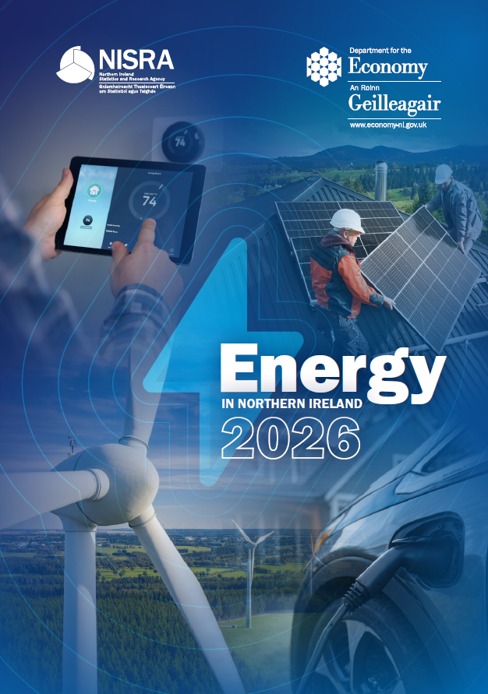
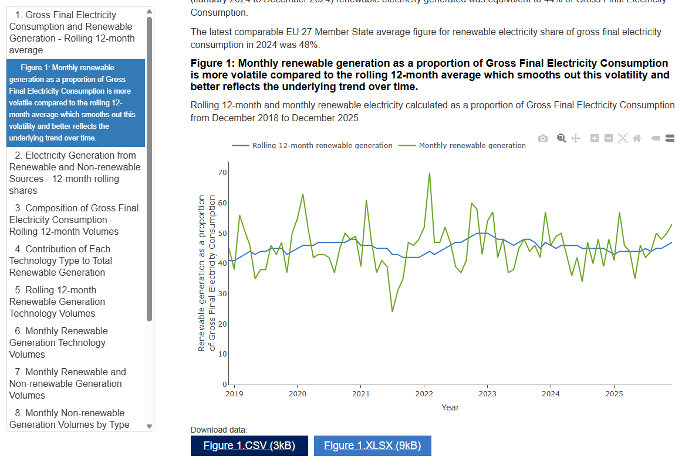
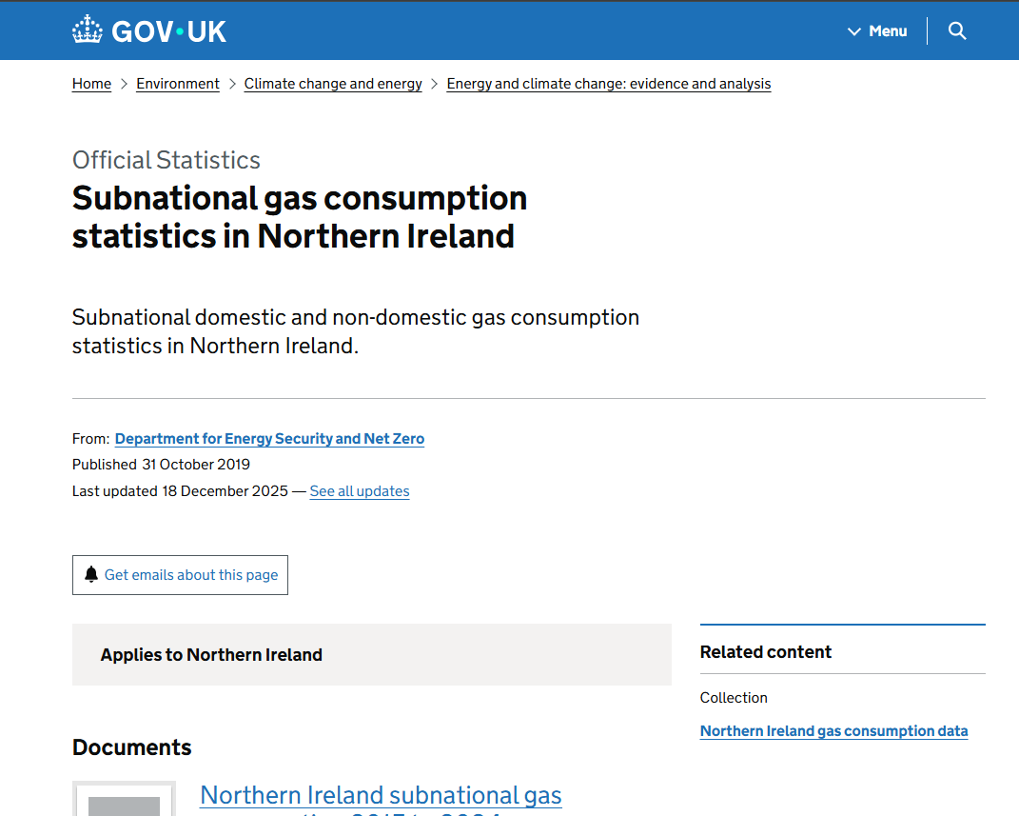
Regular outputs
Key Work Area 1: Energy
Production of Biennial compendia-style Energy in Northern Ireland report – latest is 2026 (2016 – date)
Quarterly reporting on Electricity Consumption and Renewable Generation
(March, June, September, December each year)
Annual provision of District Council level NI Gas data to DESNZ for publication of Subnational gas consumption in Northern Ireland

Slide 31
Key work area 2: Circular Economy
Key outputs:
Producing statistical publications, research and analytical outputs on key circular economy indicators.
Material and carbon footprint – annually.
Circular economy behaviours output (new publication sourced from NISRA Continuous Household Survey planned for Autumn 2026).

Slide 32
Energy Intelligence Team - Statisticians
Deputy Principal (Energy System Modelling and Research)
Assistant Statistician
Deputy Principal (Energy Strategy Targets and Energy Management)
Assistant Statistician
Deputy Principal (Energy Efficiency)

Slide 33


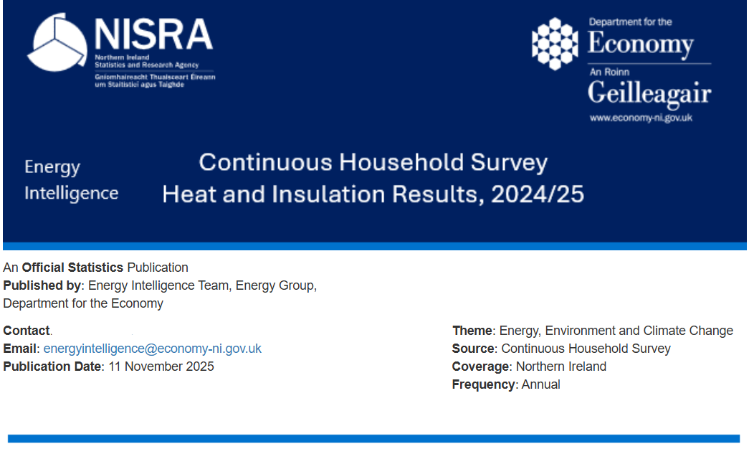
Core Outputs
Energy Strategy Targets and Metrics Monitoring
Continuous Household Survey Heat and Insulation Results
Energy Evidence Programme

Slide 34
Analysis and Evidence - 2026/27 Priorities
  Strategic Analysis
  Maintenance and quality assurance of NI base-year dataset for modelling of net zero pathways.
  Assessment of policy options and interventions for teams across Energy Group.
  Analytical support for annual Energy Strategy Action Plans and Reports
  Projects
  Energy Carbon Data Repository (ECDR) - quality assurance and production of metrics for the Energy Management Strategy target.
  Provide a core analytical and research support to the Department and its customers, associated with the Energy Strategy and Climate Change Act.
  Support modelling, quantification and reporting of Climate Action Plans.
  User engagement with policy teams to ensure access to survey information and development of questions (CHS, FRS & HCS) are aligned with need.
  Production of monitoring reports and management of the research programme to ensure evidence feeds into policy development effectively.

Slide 35
Strategic Data Assets
The Database for Trade and Economic Research (DTER) (2019 – date) enables the production of ad-hoc analysis and outputs. A further update is planned during 2026 for Northern Ireland business energy purchases provisional estimates 2016 to 2018, to reflect more recent data.
NI Energy Transition Model Dataset - Large scale collation of data to underpin the future modelling of the NI energy system.
We will engage with policy areas and analytical colleagues within the NICS and across the UK to support development of a circular economy monitoring framework.
We will contribute to the development of relevant Census questions through Topic Expert Working Groups.

Slide 36
Enabling Digital Infrastructure
RAP (reproducible analytical pipelines) and HTML outputs are developed for the quarterly Electricity Consumption and Renewable Generation publication, Continuous Household Survey Heat and Insulation results, and a HTML publication for Material Footprint. During 2026/27 we will continue to develop outputs in HTML format and improve RAP processes.
The upcoming circular economy behavioural insights output from the Continuous Household Survey (Autumn 2026) and carbon footprint (expected September 2026) will be in HTML format.
We will develop understanding of safe and best use of AI to enhance roles and statistical / research outputs.
Assessment of API access to energy statistics and information.
We will work with NISRA colleagues to support the improvements in RAP and use of R through the RAP Working Group and R Code Peer Review Group.

Slide 37
Key Stakeholders, Purposeful Partnerships and User-focused Dissemination
1. POLICY & GOVERNMENT
2. CORE DELIVERY & ANALYTICAL
• Minister / Executive / Assembly / political representatives
• Department for Energy Security and Net Zero (DESNZ)
• Department for Agriculture, Environment and Rural Affairs (DAERA)
• Department for Environment, Food & Rural Affairs (DEFRA)
• DfE – Economic Policy; Energy Group; Circular Economy
• DfE Analytical Services Division (ASD)
• NISRA, including Economic and Labour Market Statistics
• ONS – including Environmental Accounts
• Four Nations Circular Economy Analytical Group
• NISRA Climate Change Information Group
KEY
STAKEHOLDERS
This provides an overview of the range of people and organisations that we work with inside and outside of DfE and NISRA, to enable us to produce energy, circular economy and secondary analysis outputs.
4. WIDER STAKEHOLDERS & USERS
3. MARKET & SYSTEM OPERATORS
• Researchers / academics
• Journalists
• Public
• NI Housing Executive
• Invest NI
• Consumer Council NI
• NIE Networks
• System Operator for Northern Ireland (SONI) / EirGrid
• Utility Regulator NI
• Northern Ireland Gas Network Operators

Slide 38
User-focused dissemination
We recently conducted a formal user engagement exercise on the quarterly Electricity Consumption and Renewable Generation publication and methodology (overview on next slide). We will learn from this process for future engagement with users and share learnings with others, as appropriate.
We will add feedback forms to all our regular outputs to gain feedback from users.
We will expand the availability of data on the NISRA Data Portal.
We also work with NISRA’s Dissemination Branch and DfE Press Office to ensure our outputs reach as wide an audience as possible and in the right formats.
In 2026/27 we will consider options for short factsheets and outputs to address data gaps and enhance analytical insight.
We will deliver statistics briefings for DfE staff at relevant publication points for official statistics, or where there is substantive new analysis, with sessions held on or close to the day of release where appropriate.
We will work with the NISRA Dashboard Advisory Group to implement best practice in the presentation of information.

Slide 39
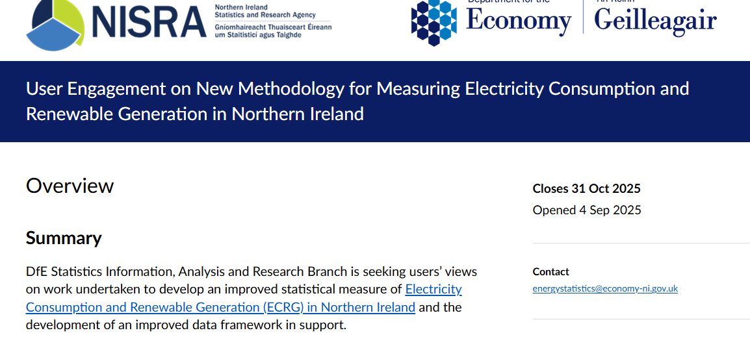
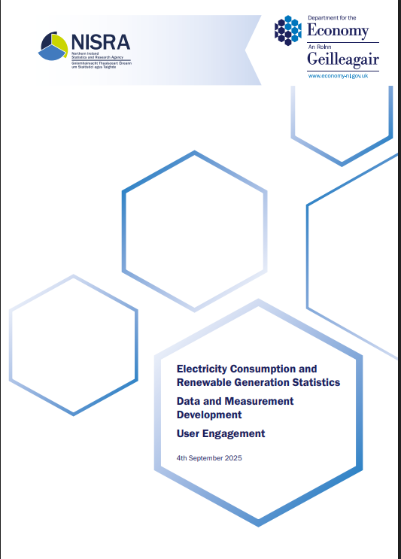
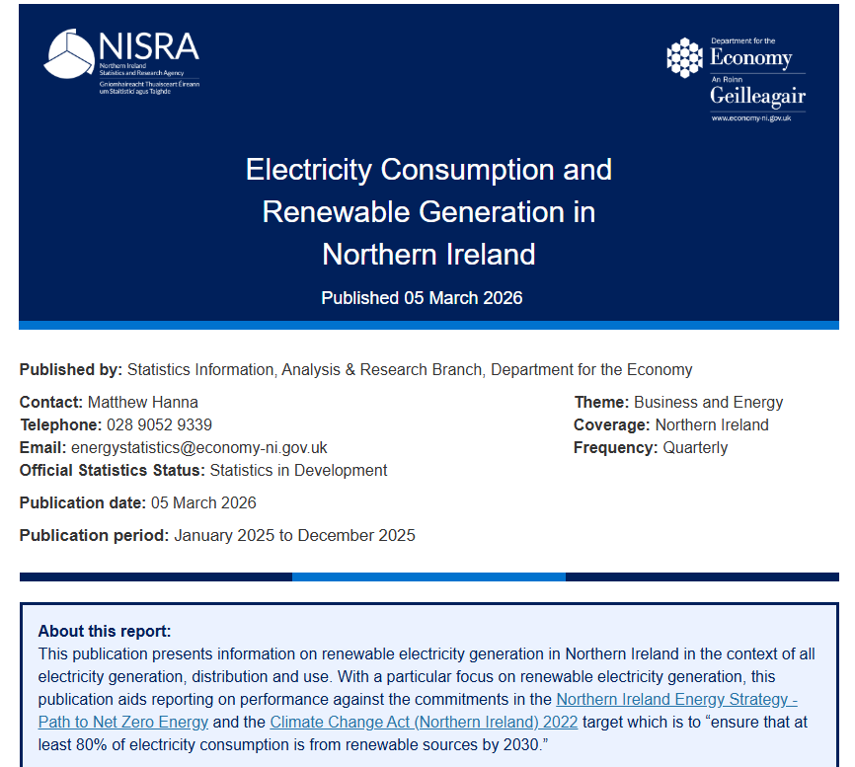
Electricity Consumption and Renewable Generation (ECRG)
Recent history and focus
Review of ECRG measure
Stakeholder discussion:
DfE policy, NIUR, DESNZ,
NIEN, SONI, 80 by 30 group, CCIG…
Development of new data framework
Formal User Engagement
Development of new HTML report
Aids reporting on Energy Strategy and Climate Change Act target:
“ensure that at least 80% of electricity consumption is from renewable sources by 2030”

Slide 40
Purposeful Partnerships
Through participation in the voluntary Four Nations Circular Economy Analytical Group, we will collaborate regularly to share learning and best practice, address common analytical challenges, and identify opportunities for alignment and joint working.
Engagement with the NISRA Climate Change Information Group (CCIG) will support the sharing of updates on work programmes, identification of collaboration opportunities, contributing to a more coherent approach to climate-related information.
Participation on the UK Climate Analytical Group to collaborate across UK analysts working on net zero strategies and associated modelling and analysis.

